Slide 1
Lecture 12 - Communications in Organisations
Managing Business

Slide 2
Learning Outcomes
At the end of the lecture, you should be able to:
  Differentiate between interpersonal and organisational communication.
  Discuss the functions of communication.
  Explain all the components of the communication process.
  List the communication methods managers might use.
  Describe nonverbal communication and how it takes place.
  Explain the barriers to effective interpersonal communication and how to overcome them.

Slide 3
What Is Communication?
Communication
  The transfer and understanding of meaning.
    Transfer means the message was received in a form that can be interpreted by the receiver.
    Understanding the message is not the same as the receiver agreeing with the message.
  Interpersonal Communication
    Communication between two or more people
  Organisational Communication
    All the patterns, network, and systems of communications within an organisation

Slide 4
Four Functions of Communication
Control
Motivation
Functions of
Communication
Information
Emotional
Expression

Slide 5
Functions of Communication
Control
  Formal and informal communications act to control individuals’ behaviors in organisations.
Motivation
  Communications clarify for employees what is to done, how well they have done it, and what can be done to improve performance.

Slide 6
Functions of Communication (cont’d)
Emotional Expression
  Social interaction in the form of work group communications provides a way for employees to express themselves.
Information
  Individuals and work groups need information to make decisions or to do their work.

Slide 7
Interpersonal Communication
Message
  Source: sender’s intended meaning
Encoding
  The message converted to symbolic form
Channel
  The medium through which the message travels
Decoding
  The receiver’s retranslation of the message
Noise
  Disturbances that interfere with communications

Slide 8
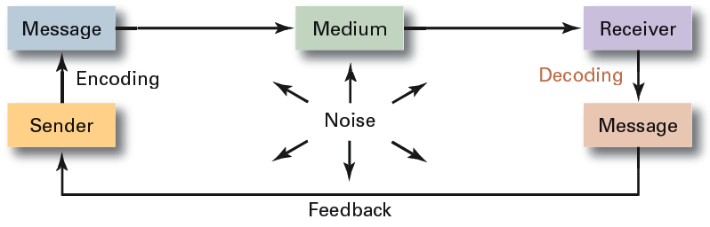
The Interpersonal Communication Process

Slide 9
Distortions in Communications
Message Encoding
  The effect of the skills, attitudes, and knowledge of the sender on the process of encoding the message
  The social-cultural system of the sender
The Message
  Symbols used to convey the message’s meaning
  The content of the message itself
  The choice of message format
  Noise interfering with the message

Slide 10
Distortions in Communications (cont’d)
The Channel
  The sender’s choice of the appropriate channel or multiple channels for conveying the message
Receiver
  The effect of skills, attitudes, and knowledge of the receiver on the process of decoding the message
  The social-cultural system of the receiver
Feedback Loop
  Communication channel distortions affecting the return message from receiver to sender

Slide 11
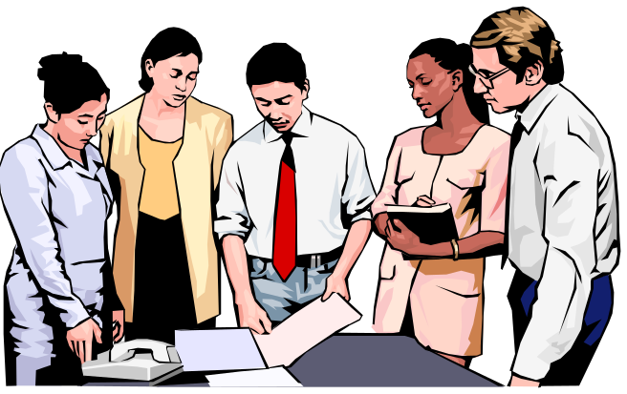
Interpersonal Communication Methods
Face-to-face
Telephone
Group meetings
Formal presentations
Memos
Traditional Mail
Fax machines
Employee publications
Bulletin boards
Audio- and videotapes
Hotlines
E-mail
Computer conferencing
Voice mail
Teleconferences
Videoconferences

Slide 12
Interpersonal Communication (cont’d)
Nonverbal Communication
  Communication that is transmitted without words.
    Sounds with specific meanings or warnings
    Images that control or encourage behaviors
    Situational behaviors that convey meanings
    Clothing and physical surroundings that imply status
  Body language: gestures, facial expressions, and other body movements that convey meaning.
  Verbal intonation: emphasis that a speaker gives to certain words or phrases that conveys meaning.

Slide 13
Interpersonal Communication Barriers
Filtering
National
Culture
Emotions
Language
Interpersonal Communication
Information
Overload
Defensiveness

Slide 14
Barriers to Effective Interpersonal Communication
Filtering
  The deliberate manipulation of information to make it appear more favorable to the receiver.
Emotions
  Disregarding rational and objective thinking processes and substituting emotional judgments when interpreting messages.
Information Overload
  Being confronted with a quantity of information that exceeds an individual’s capacity to process it.

Slide 15
Barriers to Effective Interpersonal Communication (cont’d)
Defensiveness
  When threatened, reacting in a way that reduces the ability to achieve mutual understanding.
Language
  The different meanings of and specialised ways (jargon) in which senders use words can cause receivers to misinterpret their messages.
National Culture
  Culture influences the form, formality, openness, patterns and use of information in communications.

Slide 16

Overcoming the Barriers to Effective Interpersonal Communications
Use Feedback
Simplify Language
Listen Actively
Constrain Emotions
Watch Nonverbal Cues

Slide 17
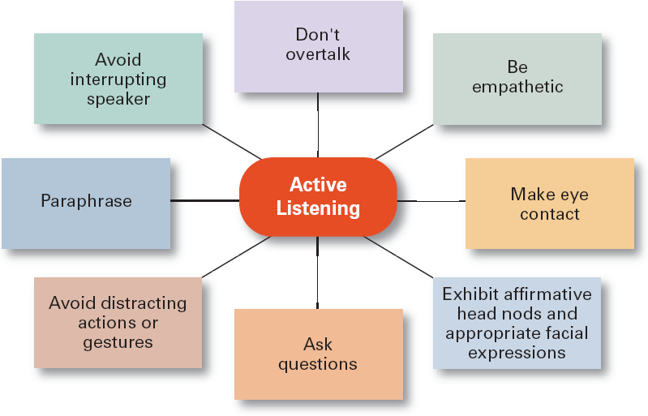
Active Listening Behaviors
Source: Based on P.L. Hunsaker, Training in Management Skills (Upper Saddle River, NJ: Prentice Hall, 2001).

Slide 18
Types of Organisational Communication
Formal Communication
  Communication that follows the official chain of command or is part of the communication required to do one’s job.
Informal Communication
  Communication that is not defined by the organisation’s hierarchy.
    Permits employees to satisfy their need for social interaction.
    Can improve an organisation’s performance by creating faster and more effective channels of communication.

Slide 19

Communication Flows
Diagonal
Upwa
r
d
Downwa
r
d
Lateral

Slide 20
Direction of Communication Flow
Downward
  Communications that flow from managers to employees to inform, direct, coordinate, and evaluate employees.
Upward
  Communications that flow from employees up to managers to keep them aware of employee needs and how things can be improved to create a climate of trust and respect.

Slide 21
Direction of Communication Flow (cont’d)
Lateral (Horizontal) Communication
  Communication that takes place among employees on the same level in the organisation to save time and facilitate coordination.
Diagonal Communication
  Communication that cuts across both work areas and organisational levels in the interest of efficiency and speed.

Slide 22
Types of Communication Networks
Chain Network
  Communication flows according to the formal chain of command, both upward and downward.
Wheel Network
  All communication flows in and out through the group leader (hub) to others in the group.
All-Channel Network
  Communications flow freely among all members of the work team.

Slide 23
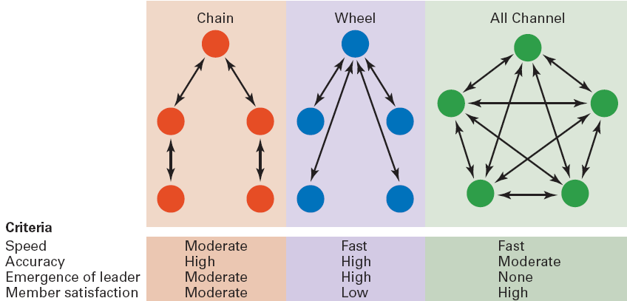
Three Common Organisational Communication Networks and How They Rate on Effectiveness Criteria

Slide 24
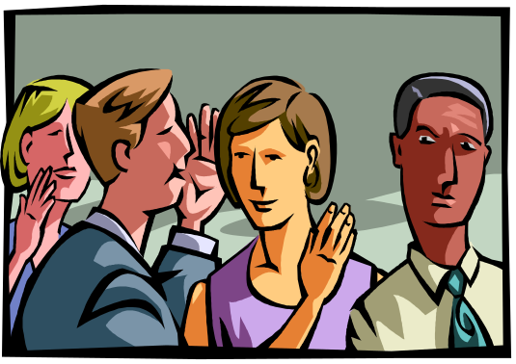
The Grapevine
An informal organisational communication network that is active in almost every organisation.
  Provides a channel for issues not suitable for formal communication channels.
  The impact of information passed along the grapevine can be countered by open and honest communication with employees.

Slide 25
Summary of Main Teaching Points
Explain how communication can flow in an organisation.
Describe the three common communication networks.
Discuss how managers should handle the grapevine.

Slide 26
Question and Answer Session
Q & A

